Slide 1
Smerge: Smarter Merge
Conflict Resolutions
Alva Wei (alvawei) Jediah Conachan (jediah6)
Kenji Nicholson (kenjilee)
Steven Miller (stevenm62)
Sungmin Rhee (srhee4)

Slide 2
Motivation
Version control systems (VCSs) use line-based analysis to detect merge conflicts
Unable to automatically resolve many merge conflicts, so developers have to resolve them manually
Git (most popular VCS)
Capable of merging whitespace conflicts
Conservative to prevent undesired merges
Git mergetools
All-in-one merge solutions: GUI, code editor, automatic merge facility
Manual merges = valuable developer time = more $$$ spent on projects
Goal: Reduce the number of conflicts presented to the users
Automatically handle as many merge conflicts as possible
Notes:
Should we include any examples here? His feedback said to include a real world example, but we’re doing that later in the demo, right? It could use one but I’m undecided..
I think it might be a good idea to show the example here to help motivate the problem and then run through it during the demo to show that our tool solves it

Slide 3
Merge Conflict Example
1 # Common Ancestor (Base):
2 for batch_index in range(0, nb_batch): 3 batch_start = batch_index*batch_size 4 batch_end = min(len(X), (batch_index+1)*batch_size) 5 batch_ids = index_array[batch_start:batch_end]
Example from: Keras: Deep Learning for humans - https://github.com/keras-team/keras
Notes:
Mention that this example is from the keras repository

Slide 4
Merge Conflict Example (cont.)
1 # Theirs (Remote): 2 for batch_index, (batch_start, batch_end) in enumerate(batches): 3 batch_start = batch_index*batch_size 4 batch_end = min(len(X), (batch_index+1)*batch_size) 5 batch_ids = index_array[batch_start:batch_end]
1 # Yours (Local): 2 for batch_index in range(0, nb_batch): 3 batch_start = batch_index*batch_size 4 batch_end = min(len(X), (batch_index+1)*batch_size) 5 if shuffle: 6 batch_ids = index_array[batch_start:batch_end] 7 else: 8 batch_ids = slice(batch_start, batch_end)
Example from: Keras: Deep Learning for humans - https://github.com/keras-team/keras
Notes:
Red portions = respective changes made
This shouldn’t be a conflict, ideal solution would be to keep both of the changes that both developers made during the merge

Slide 5
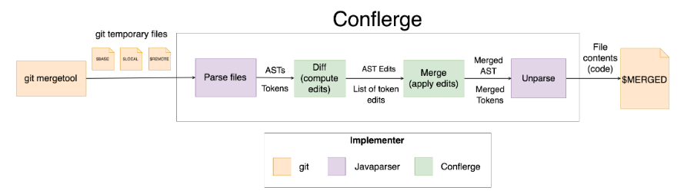
Current Approaches: Conflerge
Uses abstract syntax tree (AST) merging to automatically resolve conflicts
Dependency on JavaParser means only compatible with Java
JavaParser, however, guarantees an AST represents valid Java code
Discards custom whitespace placed by contributors
https://github.com/ishansaksena/Conflerge
Notes:
Conflerge is a git merge tool that is used for java projects. It is basically a wrapper around Javaparser, which produces ASTs out of source code. Conflerge takes these ASTs and runs a merging algorithm on them. Some of the downsides are:
The result of a merge is all formatted according to the default Javaparser formatting -- any custom whitespace for example is not preserved. This is a problem since many developers use whitespace for code clarity purposes. This means that the developer must manually reinsert it and commit the code again.
Since Conflerge uses Javaparser, languages other than java are not supported.
When there is a failure to merge (tool couldn’t resolve the merge conflict), give example of a failure and show the output on the side? (in the last presentation, we said that no information was given to the user-- which is what I thought according to what the contributor to conflerge told me, but Bryan said he got a lot of exceptions he didn’t understand. If we can reproduce this it might be a good idea to include it, or just give screenshots of whatever failures we get and talk about those.)
Incl. example of simple merge that git can handle, but an example of one it cannot solve.

Slide 6
Our Approach
Centered on a language independent AST
Our AST provides the following benefits:
Specialized for merging algorithms (don’t have to work around other existing AST formats)
Merging algorithms also become language independent
Retaining source code for unparsing the final merged tree
Allows for whitespace conservation
Control and flexibility
Notes:
Define generic ast

Slide 7
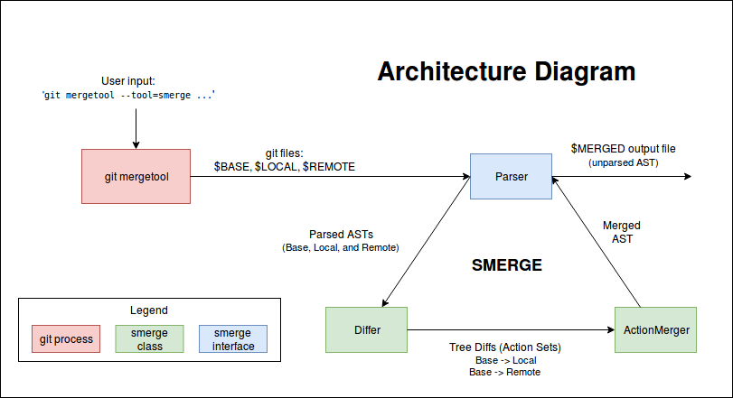
High Level Operations
Similar to Conflerge’s, but completely different on the inside.

Slide 8
Parsing
Must parse source code files into our generic AST
Requires a separate Parser for each language
Each parser must implement our Parser interface
Requires methods for parsing and unparsing
We implemented our own simple Python Parser
Base, local, and remote files are parsed line-by-line into our generic AST
AST nodes store type, content, indentation, and an ID (for matching)
If a language requires more complex nodes, these nodes can be easily extended

Slide 9
Merging Process
Input: BASE, LOCAL, REMOTE ASTs
Compute tree diffs BASE→LOCAL and BASE→REMOTE
First, match the nodes between all three trees
Second, detect differences between BASE and LOCAL, and BASE and REMOTE
Tree diffs are represented as a set of actions (insert, delete, update a node)
Merge and apply both diffs onto BASE
A fairly complicated process, especially where conflicts occur
Output: a modified BASE AST, unparsed into merged source code

Slide 10
Conflict handling
Conflerge’s solutions:
Imports
If a conflict involves import statements, keep all import statements
Comments:
If two users update a comment, keep the base version
Otherwise:
Unresolvable conflict
Conflerge would fail
Smerge imitates git merge
<<<<<<<<<< REMOTE
__version__ = ‘1.0.3.dev’
==========
__version__ = ‘1.0.2.dev’
==========
__version__ = ‘1.1.dev’
>>>>>>>>>> LOCAL
Example from Flask - https://github.com/pallets/flask

Slide 11
Evaluation
Question: How successful is Smerge at reducing conflicts?
Hypothesis: Smerge will reduce the number of merge conflicts experienced by the programmer
Procedure
Gather many GitHub repositories and their respective historical data
From the historical data, look for merge commits that have two parents
Use Smerge’s merging algorithm and record metric information automatically.
Compare the human resolution to the resolution presented by Smerge manually and categorize it into true and false positives and negatives.

Slide 12
Metrics for Automation
Conflicts: The number of merge conflicts found in the repo by git merge. A conflict is counted as a conflicting portion.
Modified: The conflicts that Smerge modified because it deemed the conflicts automatically resolvable.
Unresolved: The conflicts that Smerge aborted because it deemed merging would result in possibly undesired behavior.
Notes:
These metrics help us classify whether the tool attempted to merge a conflict or not

Slide 13
Automatic Results
Repository | #Conflicts | #Modified | #Unresolved | % Modified | %Unresolved
pipenv | 234 | 215 | 19 | 91 | 8
TensorFlow Models | 28 | 23 | 5 | 82 | 17
Keras | 1052 | 871 | 181 | 82 | 17
flask | 422 | 379 | 43 | 89 | 10
XX-net | 14 | 12 | 2 | 85 | 14
ansible | 933 | 814 | 119 | 87 | 12
scikit-learn | 1761 | 1383 | 378 | 78 | 21
TOTAL: | 4444 | 3697 | 747 | 83 | 16
Notes:
These are the results we got after running our scripts
Categorizes all conflicts found into modified and unresolved, basically whether the tool decided to modify it or not

Slide 14
Metrics for Manual Categorization
 | Positives (“Modified”) | Negatives (“Unresolved”)
True | Tool does not detect merge conflicts AND performs the merge correctly | Tool detect merge conflicts AND merge requires manual resolution
False | Tool does not detect merge conflicts BUT performs the merge incorrectly | Tool detect merge conflicts BUT merge can be done automatically
Notes:
Positive and Negative = whether the tool detects merge conflict or not True and False = whether the tool was correct or not

Slide 15
Criteria
True Positives:
If developer added new code, ignore it
Mismatch in whitespace
Choosing wrong variable between two equally likely choices
False Positives:
Tool loses code in some cases
Code gets put in incorrect order
True Negatives:
Differences in println statements, comments, string values
False Negatives:
Tool sometimes doesn’t merge when one commit is blank

Slide 16
Manual Categorization Results
Repository | # Conflicts | # T-Pos | # F-Pos | # T-Neg | # F-Neg
pipenv | 234 | 93 | 122 | 8 | 11
TensorFlow Models | 28 | 12 | 11 | 5 | 0
XX-net | 13 | 3 | 8 | 2 | 0
flask | 422 | 172 | 207 | 24 | 19
TOTAL: | 697 | 280 | 348 | 39 | 30
Only manually checked 697 conflicts due to time constraints
83% were modified by Smerge, 45% of those were correctly resolved
Notes:
Only manually checked ~700 conflicts due to time constraints
Smerge attempted to automatically merge 83% of conflicts it encountered
Manual inspection of the results revealed that 45% were correctly merged

Slide 17
Conclusions
High amount of false-positives is concerning
Caused by tool not recognizing all possible merge cases
Validity threats
Sample selection bias
We select a small # of repos
Undercoverage bias
Edge cases where tool is close to useless

Slide 18
Future Work & Goals
Conservativity: Reduce the amount of cases where tool exhibits undesirable behavior (false-positives)
Parsing: Adding more language parsers to support more languages
There is also room to improve our Python Parser (such as parsing method parameters into separate nodes)
Git Merge Integration: Rework tool as git merge strategy (our tool is essentially an alternative non-line-based merging strategy)
Git Mergetool Feature: Smerge may work well as a feature to an existing git mergetool (imagine a “Smart Merge” option in kdiff3)
Notes:
Parsers: Currently, Smerge is only compatible with the Python parser/unparser we developed. In the future, we see support for every language a very realistic goal as all it requires is to parse the language into the format of the generic AST previously described.
Advanced Parsers: Currently, our python parser lacks advanced functionality. For example, it parses method headers as a single node. Ideally, a method header could be parsed into multiple nodes consisting of method parameters, which would allow for more fine tune merging, and thus more conflict resolutions.
Git Merge Integration: Currently our tool can only be run by a client as a git mergetool, which was very easy to set up. We feel however that our tool would work better as a git merge strategy, which seems much more difficult and time consuming to integrate into git.
Conservativity: Currently, our tool has a high percentage of false positives, which is the worst case scenario regarding the output. In the future, adding support for the multitude of cases that arise during merging will help reduce this number. By support, we mean the ability to detect whether the tool knows how to handle a certain case or not. While this may increase the number of false negatives, false negatives are always a better outcome than false positives under the context of our tool.

Slide 19
Related Work
Flexible Tree Matching, http://theory.stanford.edu/~tim/papers/ijcai11.pdf
Abstract Syntax Tree Matching, http://shodhganga.inflibnet.ac.in/bitstream/10603/36935/12/12_chapter%204.pdf
Designing a Tree Diff Algorithm Using Dynamic Programming and A*, http://thume.ca/2017/06/17/tree-diffing/#the-algorithm
Fine-grained and Accurate Source Code Differencing, https://hal.archives-ouvertes.fr/hal-01054552/document

Slide 20
Questions?

